Slide 1







GitHub, Debugging, Searching
Git and GitHub, Debugging, Search Techniques for Developers
GitHub
SoftUni Team
Technical Trainers
Software University
http://softuni.bg

Slide 2


Table of Contents
GitHub
How to Save Your Work Online?
Using the Debugger
Tracing the Program Execution, Breakpoints, Watches
Searching for Developers
Google, MSDN, Stack Overflow, …

Slide 3
Have a Question?
sli.do #5956

Slide 4
GitHub
The Social Network for Developers

Slide 5

What is Git?
Git
Distributed source-control system
Work with local and remote repositories
Git Bash – command line interface for Git
Free, open-source
GitHub is the world's #1 source code hosting site
Free for open-source projects
Paid plans for private projects

Slide 6
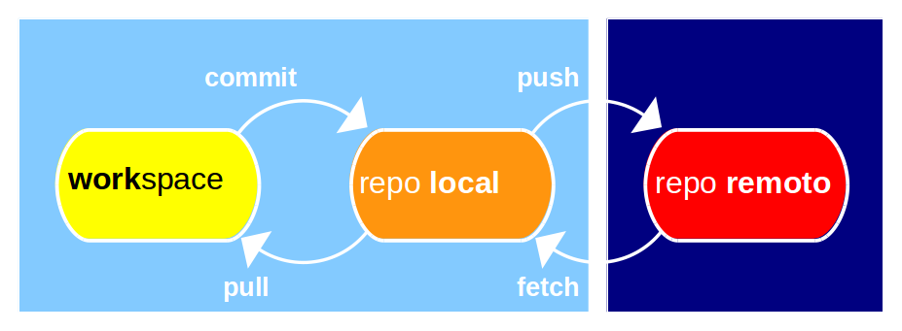
Git: How It Works?
Local computer (your laptop)
Remote repository (e.g. GitHub.com)

Slide 7
Git and GitHub Terminology
Repository (repo)
Keeps your project files (local and remote repo)
Clone a remote repository
Download a working copy from GitHub to your computer
Commit changes
Save your changed files to the local repository (not in GitHub!)
Sync (synchronize changes)
Pull from GitHub – download (fetch) latest changes & merge them
Push to remote repository – upload the changes to GitHub

Slide 8
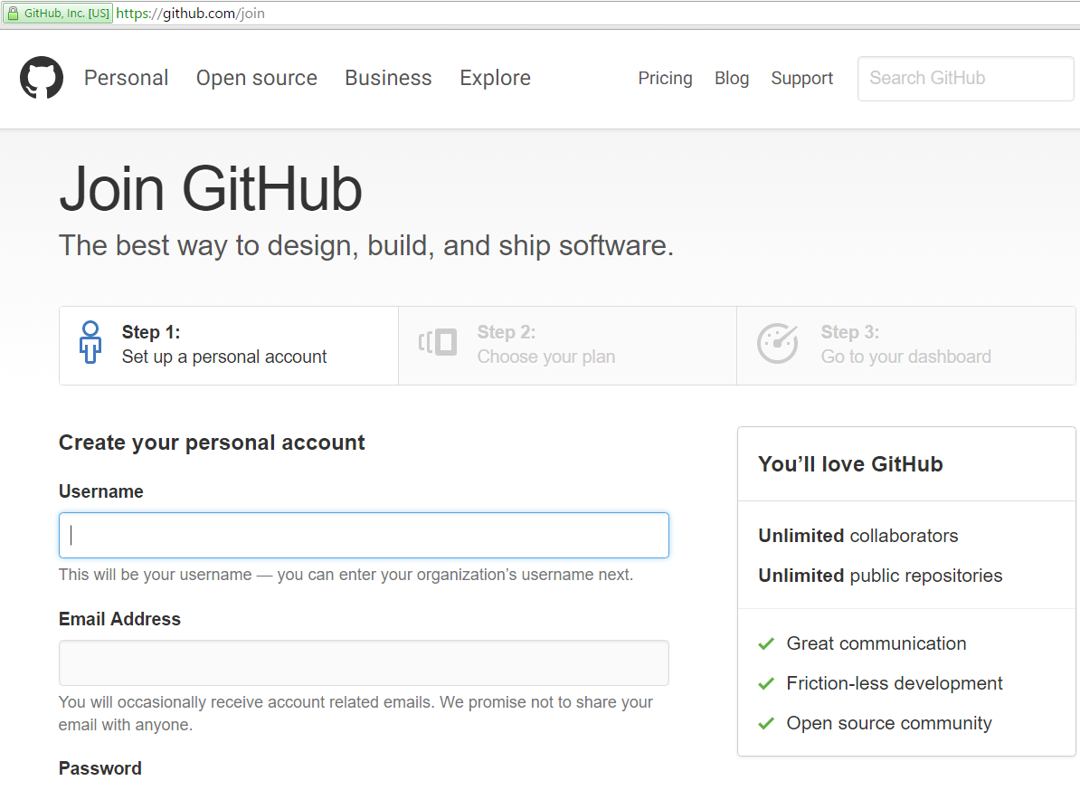
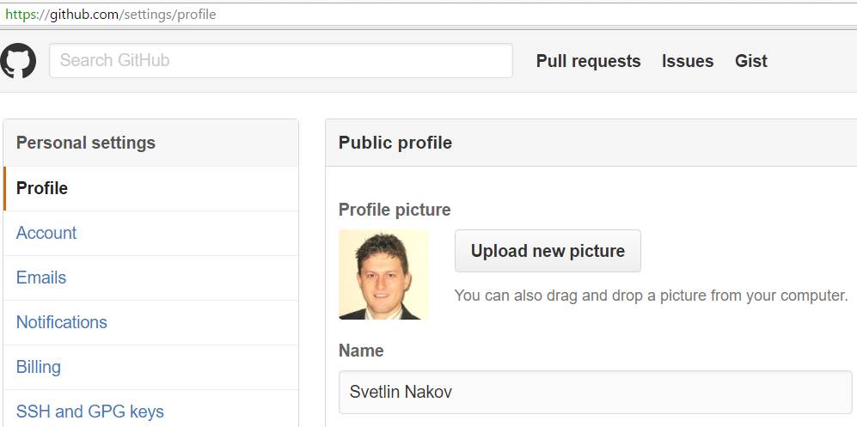
Exercise: Create Your Own Profile at GitHub
Create a GitHub account at https://github.com

Slide 9
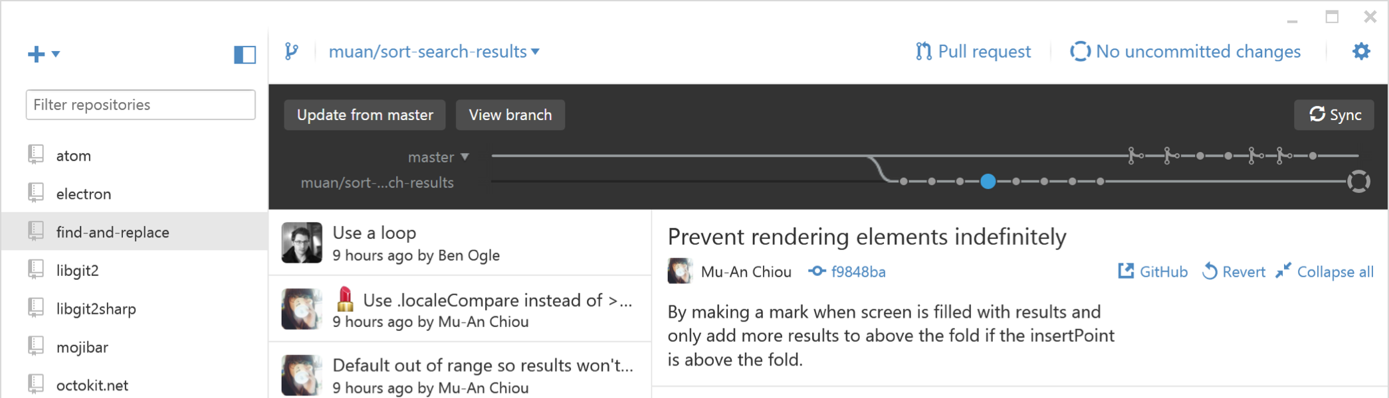
Exercise: GitHub Desktop Client Software
Download and install "GitHub Desktop"
https://desktop.github.com
Or the console-based git client – https://git-scm.com/downloads

Slide 10
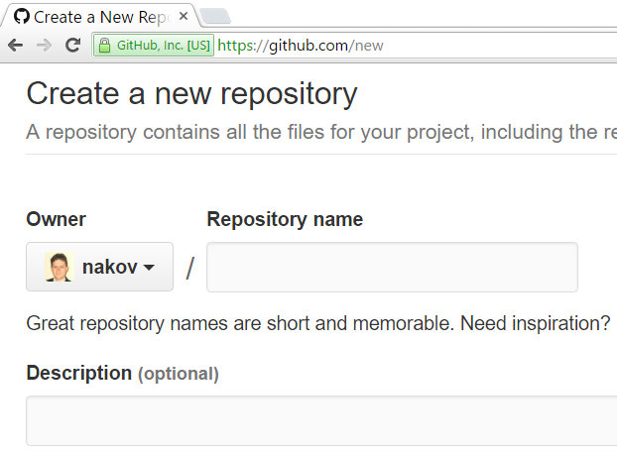
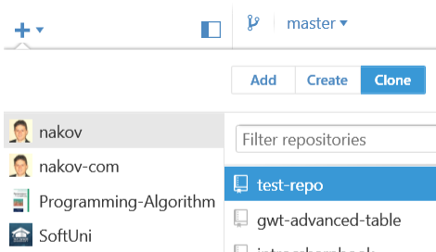
Exercise: Create and Clone a Repository
Work into teams of 5-10 students in class
Online students work alone or form own teams
Each team selects a "team leader"
The team leader creates a repository in GitHub
New repository form: https://github.com/new
Choose a name for the repo, e.g. "test-repo"
The other team members clone the repository
GitHub Desktop → Clone "test-repo"

Slide 11

Exercise: Add a File to GitHub
Team members add a few files:
Clone the "test-repo" into your computer (if not cloned yet)
Create a new file into your working directory
Name the new file <your_name>.txt
Put some text in it the file, e.g. "My name is …"
Commit the new file to your local repository
Sync the changes to upload your file to the remote repo
Browse the repo from https://github.com/user/repo to check whether your file is successfully uploaded in GitHub

Slide 12

Exercise: Create a Conflict & Merge
All team members create a common file config.txt
Each team member adds some settings in config.txt
E.g. name = Peter, size = 100, email = peter@dir.bg
Each team member commits his local changes
Each team member syncs his changes
The first will succeed without conflicts
The others will have a conflict to be merged
Resolve the conflict:
Edit the merged changes + commit and sync again

Slide 13
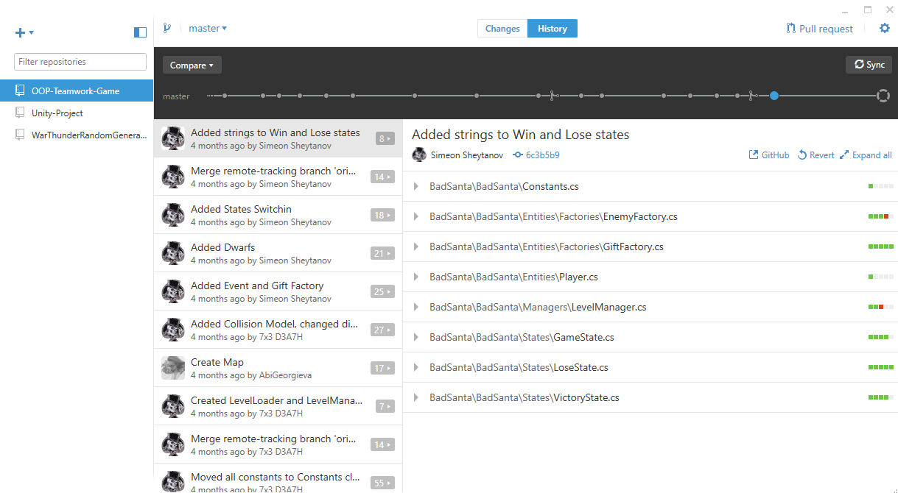

GitHub
Live Exercises in Class (Lab)

Slide 14

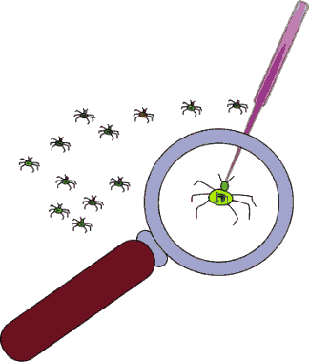
Debugging the Code
Using the Visual Studio Debugger

Slide 15



Debugging the Code
The process of debugging application includes:
Spotting an error
Finding the lines of code that cause the error
Fixing the error in the code
Testing to check if the error is gone and no new errors are introduced
Iterative and continuous process
Debuggers help a lot. Really!

Slide 16
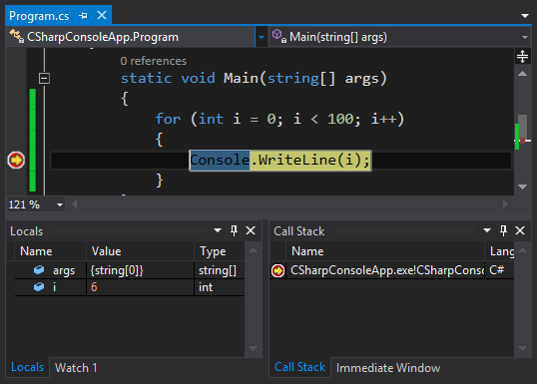
Debugging in Visual Studio
Visual Studio has a built-in debugger
It provides:
Breakpoints
Ability to trace the code execution
Ability to inspect variables at runtime

Slide 17
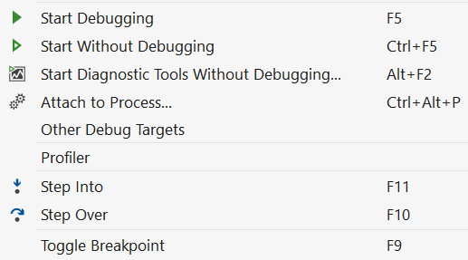
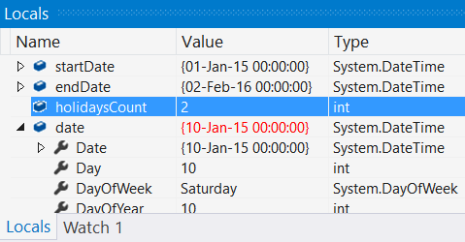
Using the Debugger in Visual Studio
Start without Debugger: [Ctrl+F5]
Toggle a breakpoint: [F9]
Start with the Debugger: [F5]
Trace the program: [F10] / [F11]
Using the Locals / Watches
Conditional breakpoints
Enter debug mode after exception

Slide 18
Exercise: Find and Fix the Bugs in the Code
A program aims to count the non-working days between two dates (e.g. 1.05.2015 … 15.05.2015 → 5 non-working days). Debug it!
var startDate = DateTime.ParseExact(Console.ReadLine(),
"dd.m.yyyy", CultureInfo.InvariantCulture);
var endDate = DateTime.ParseExact(Console.ReadLine(),
"dd.m.yyyy", CultureInfo.InvariantCulture);
var holidaysCount = 0;
for (var date = startDate; date <= endDate; date.AddDays(1))
if (date.DayOfWeek == DayOfWeek.Saturday &&
date.DayOfWeek == DayOfWeek.Sunday) holidaysCount++;
Console.WriteLine(holidaysCount);
Check your solution here: https://judge.softuni.bg/Contests/Practice/Index/204#0

Slide 19
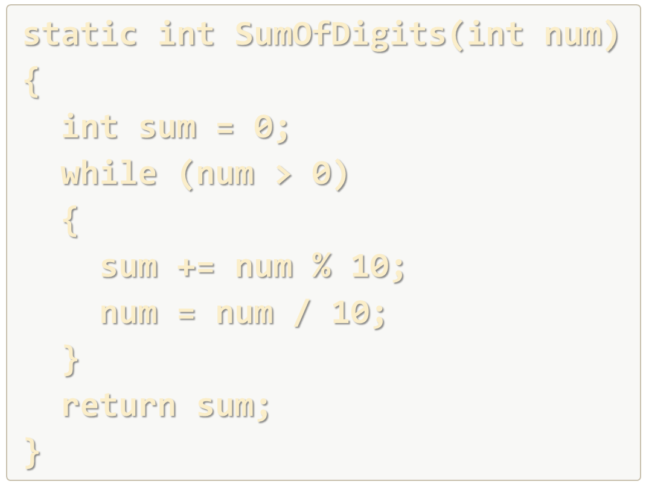
Debugging
Live Exercises in Class (Lab)

Slide 20
Searching Skills for Developers
Google, MSDN, Stack Overflow

Slide 21
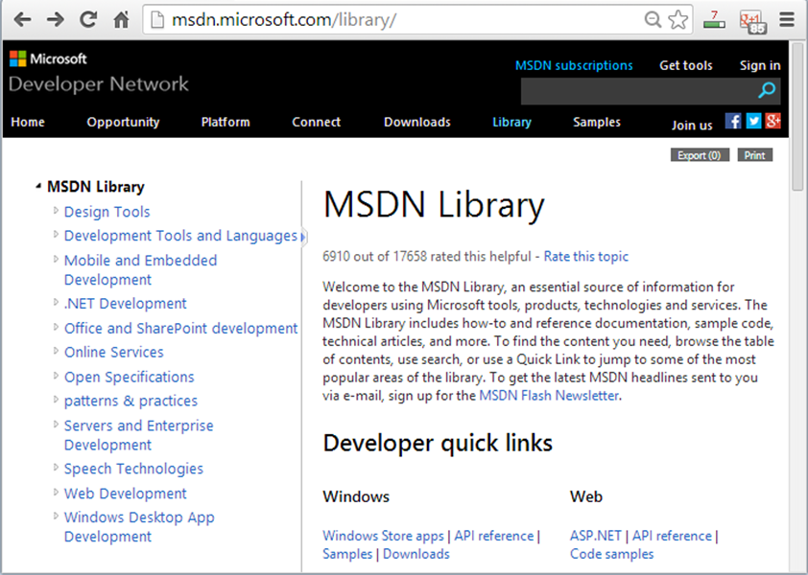
What is "MSDN Library"?
MSDN → complete documentation of all .NET API classes
Descriptions of all methods, properties, events, etc.
Code examples for each method
For all Microsoft technologies
Related articles
Library of samples
MSDN Library is available at msdn.microsoft.com/library

Slide 22

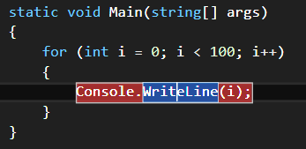
How to Use MSDN Library?
Search in Google for certain class / method / property
E.g.
Or
Or
Use Visual Studio's built-in help system
Press [F1] in Visual Studio in the code
Browse http://msdn.microsoft.com
Press [F1] to open the documentation

Slide 23



Search in Google Tips
Explicit phrase: use quotes, e.g. "using System"
Exclude words: use -word
Site specific search: use site:somesite.com

Slide 24
Exercise: Double Palindromes
Write a program to print the first 129 numbers that are palindromes and their binary representation is also a palindrome. Search in Google!
0, 1, 3, 5, 7, 9, 33, 99, 313, 585, 717, 7447, 9009, 15351, 32223, 39993, 53235, 53835, 73737, 585585, 1758571, 1934391, 1979791, 3129213, 5071705, 5259525, 5841485, …
Number | Binary | Palindrome? | Binary Palindrome?
0 | 0 | yes | yes
1 | 1 | yes | yes
2 | 10 | yes | no
633 | 1001111001 | no | yes
717 | 1011001101 | yes | yes
1023 | 1111111111 | no | yes
Check your solution here: https://judge.softuni.bg/Contests/Practice/Index/204#1

Slide 25

Searching Skills for Developers
Live Exercises in Class (Lab)

Slide 26


Summary
Use GitHub to prevent losing your work and collaborate in a team
Clone – make a working copy of repository
Sync – pull, merge and push changes
Handling conflicts – edit, commit, sync again
Debugging is really useful for finding bugs
Using breakpoints, watches, tracing the code
Learn how to search efficiently in Google

Slide 27








GitHub, Debugging, Searching
https://softuni.bg/courses/programming-basics/

Slide 28
License
This course (slides, examples, demos, videos, homework, etc.) is licensed under the "Creative Commons Attribution-NonCommercial-ShareAlike 4.0 International" license
Attribution: this work may contain portions from
"Fundamentals of Computer Programming with C#" book by Svetlin Nakov & Co. under CC-BY-SA license

Slide 29






Free Trainings @ Software University
Software University Foundation – softuni.org
Software University – High-Quality Education, Profession and Job for Software Developers
softuni.bg
Software University @ Facebook
facebook.com/SoftwareUniversity
Software University @ YouTube
youtube.com/SoftwareUniversity
Software University Forums – forum.softuni.bg

